Slide 1
Basics of Cryptography
Aashutosh

Slide 2
Outline
Introduction to Cryptography
Private/Symmetric-key Cryptography
Public/Asymmetric-key Cryptography
Digital Signature

Slide 3
Introduction to Cryptography
Needs and Requirements
Well established needs for secure communication
  War time communication
  Business transactions
Requirements of secure communication
  Secrecy
    Only intended receiver understands the message
  Authentication
    Sender and receiver need to confirm each others identity
  Message Integrity
    Ensure that their communication has not been altered, either maliciously or by accident during transmission

Slide 4
Introduction to Cryptography
Basics
Cryptography is the science of secret, or hidden writing
It has follwoing main Components:
  Encryption
    Practice of hiding messages so that they can not be read by anyone other than the intended recipient
  Authentication & Integrity
    Ensuring that users of data/resources are the persons they claim to be and that a message has not been altered

Slide 5
Introduction to Cryptography
Terminology
Plaintext (or cleartext)
  The message.
  Denoted by M or P.
Encryption (encipher)
  Encoding of message.
  Denoted by E.
Ciphertext
  Encrypted message.
  Denoted by C.
Decryption (decipher)
  decoding of ciphertext
  denoted by D.

Slide 6
Encryption and Decryption
M
C
M
E
D
The following identity must hold true:
D(C) = M, where C = E(M)

Slide 7
Cryptography: Algorithms and Keys
A method of encryption and decryption is called a cipher.
Generally there are two related functions: one for encryption and other for decryption.
Some cryptographic methods rely on the secrecy of the algorithms.
Such methods are mostly of historical interest these days.
All modern algorithms use a key to control encryption and decryption.

Slide 8
Key Based Encryption/Decryption
K₁
K₂
M
C
M
E
D
Symmetric Case: both keys are the same or derivable from each other.
Asymmetric Case: keys are different and not derivable from each other.

Slide 9
Secret Key Cryptography
K
K
M
C
M
S
E
D
R
K is the secret key shared by both the
sender (S) and receiver (R).

Slide 10
Secrete Key Cryptography
Also called symmetric or single-key algorithms.
The encryption and the decryption key are the same.
Techniques based on a combination of substitution and permutation.
Stream ciphers: operate on single bit or byte.
Block ciphers: operate on blocks (typically 64 bits)
Advantage: simple, fast.
Disadvantage: key exchange, key management.
Examples: DES,RC4, IDEA, Blowfish, AES, etc.

Slide 11
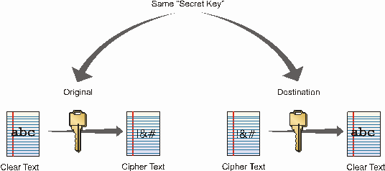
Private Key Cryptosystem
(Symmetric)

Slide 12
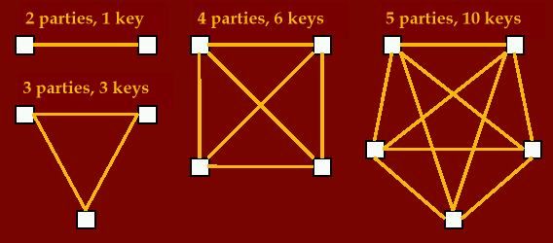
Symmetric Key - Issues
Key management, keys required = (p*(p-1))/2

Slide 13
Secrete Key Assurances
Confidentiality
  is assurance that only owners of a shared secrete key can decrypt a message that has been encrypted with the shared secrete key
Authentication
  is assurance of the identify of the person at the other end of the line (use challenge and response protocols)
Integrity
  is assurance that a message has not been changed during transit and is also called message authentication (use message fingerprint)
Non-repudiation
  is assurance that the sender cannot deny a file was sent. This cannot be done with secrete key alone (need trusted third party or public key technology)

Slide 14
Example: non-repudiation
Scenario 1:
  Alice sends a stock buy request to Bob
  Bob does not buy and claims that he never received the request
Scenario 2:
  Alice sends a stock buy request to Bob
  Bob sends back an acknowledge message
  Again, Bob does not buy and claims that he never received it
  Alice presents the ack message as proof
Can she prove that the ack message was created by him?

Slide 15
Public Key Cryptography
K_{R(pub)}
K_{R(pri)}
M
C
M
S
E
D
R
K_{R(pub)} is Receiver’s public key and K_{R(pri)} is Receiver’s private key.

Slide 16
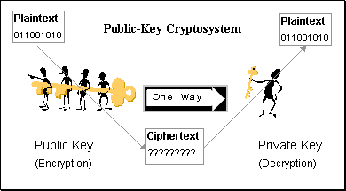
Public Key Cryptographic Algorithms
Find a hard math problem, that is easy to compute in the forward direction, but is difficult to solve in the reverse direction, unless you have some special knowledge.

Slide 17
General Strategy
Also called public-key algorithms.
Encryption key is different from decryption key.
Furthermore, one cannot be calculated from other.
Encryption key is often called the public key and decryption key is often called the private key.
Advantages: better key management.
Disadvantages: slower, more complex.
Examples: RSA, Diffie-Hellman, El Gamal, etc.

Slide 18
Simplified Math Tricks
Public key cryptography is based on the mathematical concept of multiplicative inverse.
Multiplicative inverses are two numbers that when multiplied equals one (e.g., 7 x 1/7 = 1)
In modular mathematics, two whole numbers are inverses if they multiplies to 1 (e.g., 3 x 7 mod 10 = 1)
Use modular inverse pairs to create public and private keys.
Example
  Message is 4
  To scramble it, use 4 X 3 mod 10 = 2
  To recover it, use 2 x 7 mod 10 = 4
The security of public key systems depends on the difficulty of calculating inverses.

Slide 19
Hybrid Cryptosystems
In practice, public-key cryptography is used to secure and distribute session keys.
These keys are used with symmetric algorithms for communication.
Sender generates a random session key, encrypts it using receiver’s public key and sends it.
Receiver decrypts the message to recover the session key.
Both encrypt/decrypt their communications using the same key.
Key is destroyed in the end.

Slide 20
Authentication
Basics
Authentication is the process of validating the identity of a user or the integrity of a piece of data.
There are three technologies that provide authentication
  Message Digests / Message Authentication Codes
  Digital Signatures
  Public Key Infrastructure

Slide 21
Message Digest
A message digest is a fingerprint for a document
Purpose of the message digest is to provide proof that data has not altered
Process of generating a message digest from data is called hashing
Hash functions are one way functions with following properties
  Infeasible to reverse the function
  Infeasible to construct two messages which hash to same digest
Commonly used hash algorithms are
  MD5 – 128 bit hashing algorithm by Ron Rivest of RSA
  SHA & SHA-1 – 162 bit hashing algorithm developed by NIST
Message
Message
Digest
Algorithm
Digest

Slide 22
Digital Signatures
A digital signature is a protocol the produces the same effect as a real signature.
  It is a mark that only sender can make
  Other people can easily recognize it as belonging to the sender.
Digital signatures must be:
  Unforgetable: If P signs message M with signature S(P,M), it is impossible for someone else to produce the pair [M, S(P,M)].
  Authentic: R receiving the pair [M, S(P,M)] can check that the signature is really from P.

Slide 23
Digital Signatures: Symmetric Key
Under private key encryption system, the secrecy of the key guarantees the authenticity of the message as well as its secrecy.
It does not prevent forgery, however.
There is no protection against repudiation (denial of sending a message).
An arbitrator (a trusted third party) is needed to prevent forgery.

Slide 24
Digital Signatures - Public Key
Public key encryption systems are ideally suited to digital signatures.
Reverse of public key encryption/decryption.
To sign a message, use your private key to encrypt the message.
Send this signature together with the message.
The receiver can verify the signature using your public key.
Only you could have signed the message since your private key belongs to you and only you.
The receiver saves the message and signature.

Slide 25
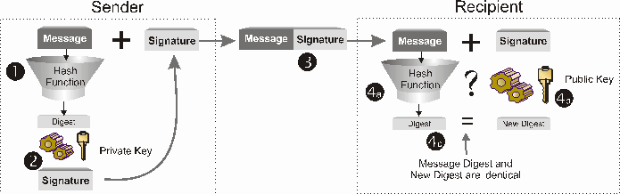
Digital Signature Process

Slide 26
Authentication
Digital Cerftificates (PKI)
A public key infrastructure (PKI) is a set of roles, policies, and procedures needed to create, manage, distribute, use, store, and revoke digital certificates and manage public-key encryption.
A digital certificate is a signed statement by a trusted party that another party’s public key belongs to them.
  This allows one certificate authority to be authorized by a different authority (root CA)
Any one can start a certificate authority
  Name recognition is key to some one recognizing a certificate authority
  Verisign is industry standard certificate authority

Slide 27

Identity
Information
Signature
Algorithm
Certificate
Sender’s
Public Key
Certificate Authority’s Private Key

Slide 28
Q & A
?

Slide 29
              THANK YOU !

Slide 30
References

